Slide 1
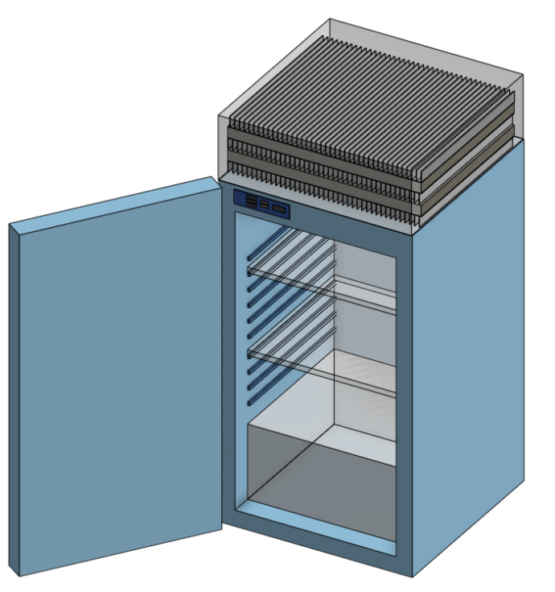
SMART REFRIGERATOR
Isabel Price, Kalino Ruiz, Caleb Mok, Brent Marin, Matthew Manuel
ME-195a
Advisor: Dr. Keith Yi
Technical Advisor: Dr. Kabbani
4/16/2025

Slide 2




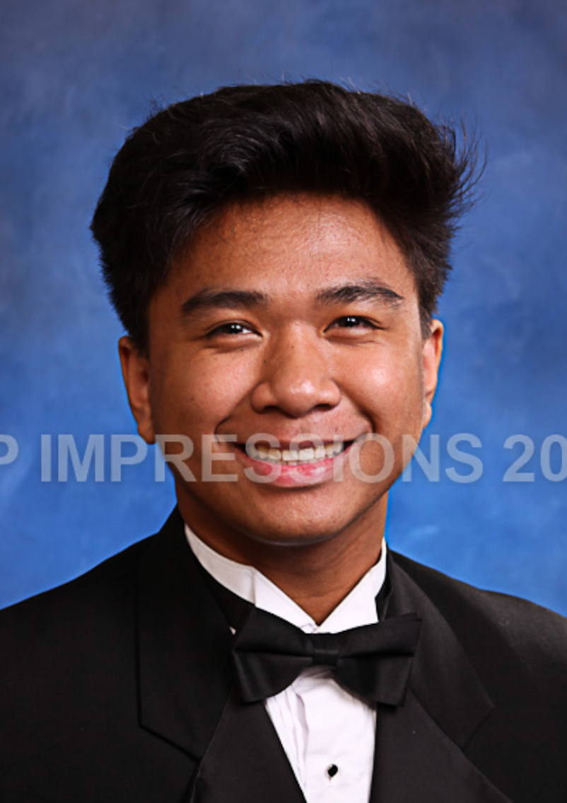
MEET THE TEAM
Kalino Ruiz
Brent Marin
Isabel Price
Caleb Mok
Matthew Manuel

Slide 3
INTRODUCTION

Slide 4
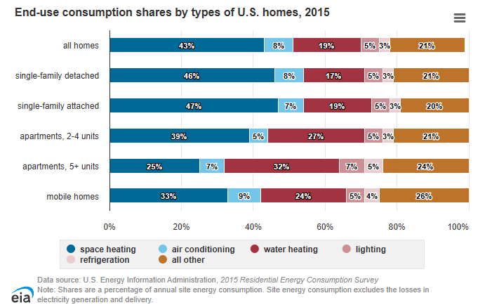
REFRIGERATOR ENERGY USE
Refrigerators are high energy use appliances
Full refrigerators use ~ 3-5% of household energy (eia, 2015)
Mini refrigerators use about a third the energy of full refrigerators
Presented by: Kalino R

Slide 5
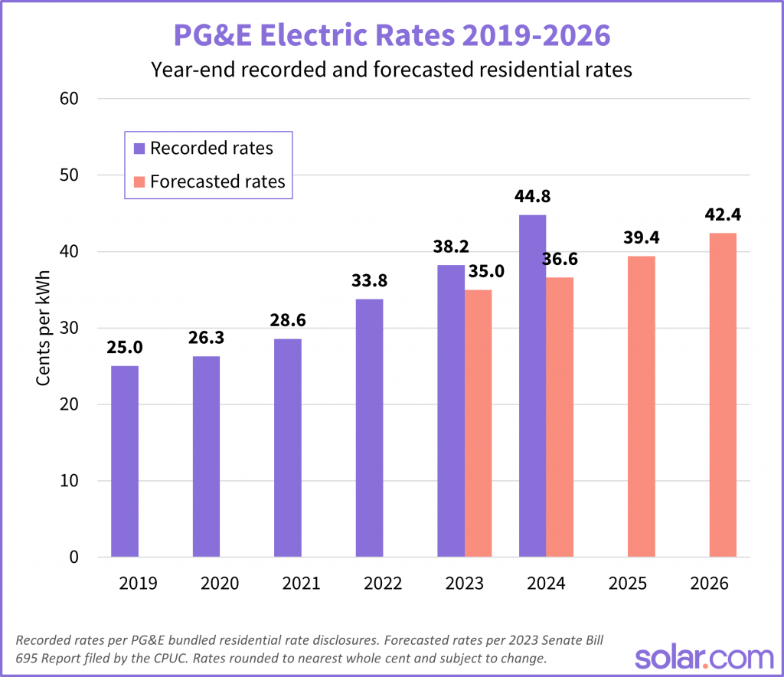
THE HIGH USE OF ELECTRICITY
PGE customers have seen their bills increase by 50% since 2019
$0.25/kWh in 2019
$0.45/kWh in 2024
Presented by: Kalino R

Slide 6
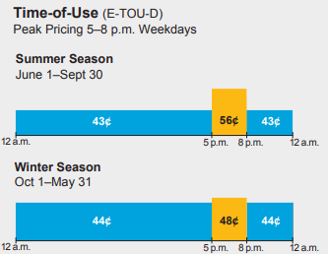
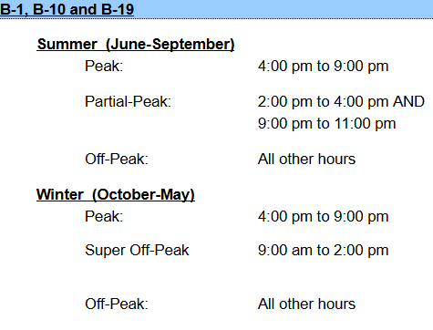
TIME OF USE UTILITY RATES
Residential TOU
Industrial TOU
Presented by: Kalino R

Slide 7
MISSION STATEMENT

Slide 8
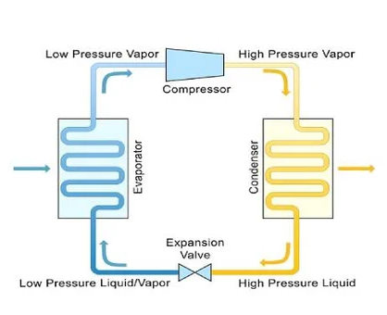


OBJECTIVE
Design and build a mini fridge that switches between an active refrigeration cycle and passive cooling mode to save money.
Active Refrigeration Cycle
Passive cooling
Presented by: Kalino R
Notes:
Should briefly explain what is active refrigeration (mention the compressor) Very briefly mention the types of passive cooling and that we are currently planning to do thermal storage/using ice. We can go more into detail about passive cooling in the background

Slide 9
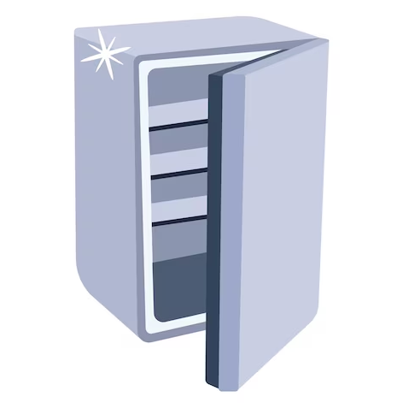
KEY GOALS
01
Make an affordable, energy-efficient, and cost saving refrigerator
02
The refrigerator has easy to clean removable shelves
03
Microcontroller controls the state of the refrigerator
Presented by: Brent

Slide 10
PRIMARY MARKET
STAKEHOLDERS
People who live in areas with high electricity rates
Young renters (such as college students)
The team
Dr. Yi
Dr. Kabbani
SJSU Mechanical Engineering Department
Presented by: Brent
Notes:
Note: These slides can be super short

Slide 11
CREATIVE DESIGN OPPORTUNITY
Passive cooling is not often utilized in fridge designs
There is no water collection and recycle loop for the ice as it melts
SCOPE LIMITATION
Small sized fridge
Money
Time constraint
Presented by: Brent
Notes:
Note: These slides can be super short

Slide 12
CUSTOMER NEEDS

Slide 13

CUSTOMER NEEDS SURVEY
Used a Google Forms Survey
Demographics
Age: 18-55+
46% male and 54% female
Half own a home and half rent
Evaluated our own priorities and compared
Presented by: Brent
Notes:
Used a survey to determine need importance
Demographic
age: 18-55+
46% male and 54% female
Half own a home and half rent
Averaged values from a 1-10 need survey
Storage space, durability, and easy to clean ranked highest among surveyees
Storage space, cost, easy to clean, and energy usage ranked highest among ourselves
Storage space and easy to clean was a top priority for both

Slide 14
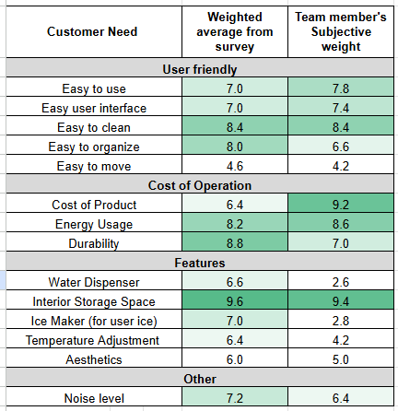
CUSTOMER NEEDS RESULTS
Highest Customer Ranked
Interior Storage Space
Durability
Easy to Clean
Highest Team Ranked
Interior Storage Space
Cost of Product
Energy Usage
Presented by: Brent

Slide 15
BACKGROUND RESEARCH
Notes:
caleb

Slide 16
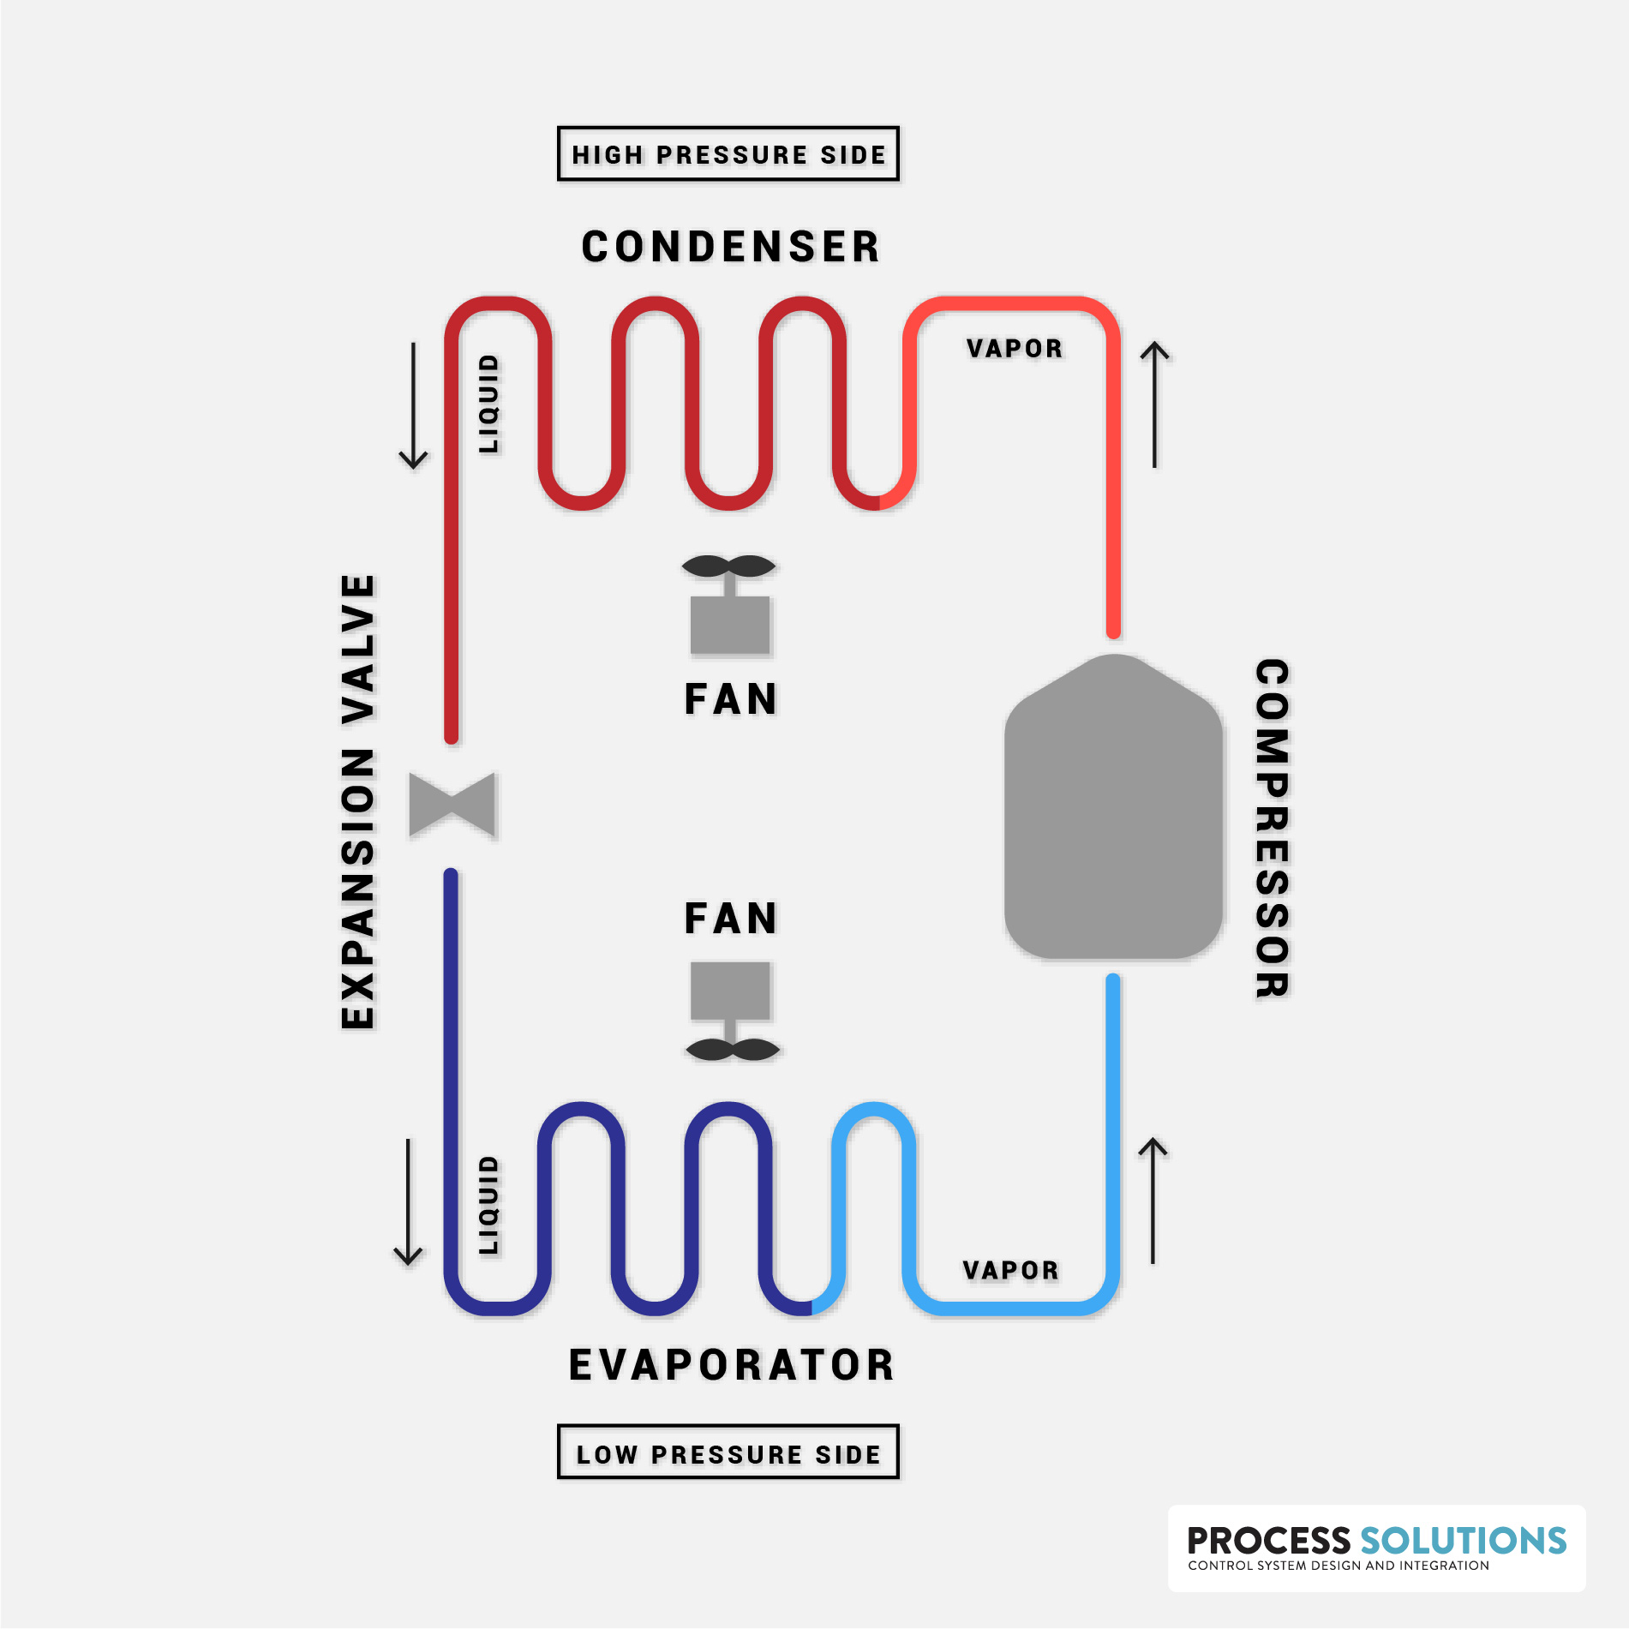
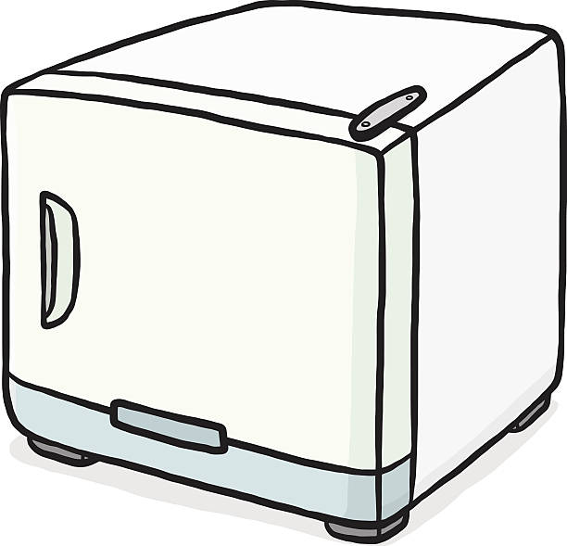
ACTIVE COOLING
The vapor compression cycle
Four Main Components:
Compressor
Condenser Coils
Expansion Valve
Evaporator Coils
Presented by: Caleb

Slide 17
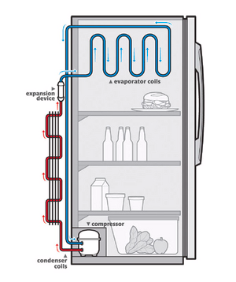
CURRENT REFRIGERATORS USE ACTIVE COOLING
Pros:
Proven effectiveness
Space Efficient
Consistent temperature control
Cons:
System is always running (on Duty Cycle)
Compressor is high energy use
Hard to manufacture from scratch
Presented by: Caleb

Slide 18
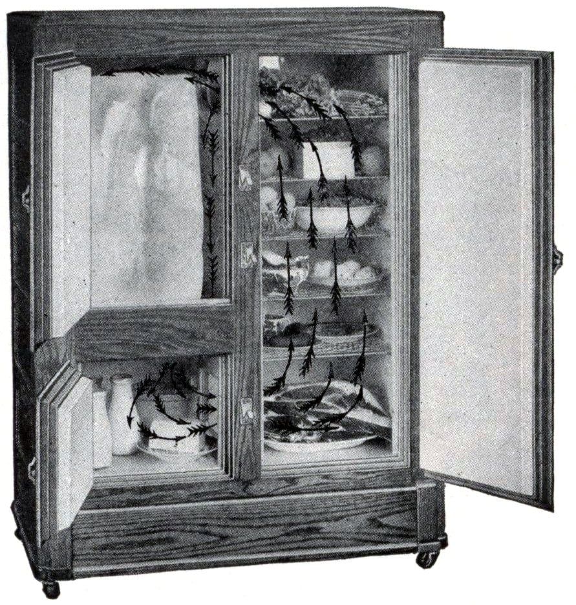
HISTORIC USE OF PASSIVE COOLING
Before there were Refrigerators, there were Iceboxes
Were used until the 1930s
No moving parts, only shelves and ice
Relied on Insulation
Had to replenish Ice
Led to advancements in humidity cycles
Presented by: Matthew

Slide 19
PASSIVE COOLING
Pros:
Saves consumer money
Simple design
Less maintenance
Cons:
No commercial/residential products
Requires more space
Presented by: Isabel

Slide 20
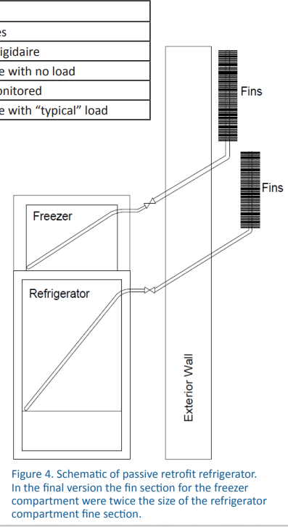
PASSIVE COOLING REFRIGERATOR PROTOTYPE
(Garber-Slaght, 2013)
Experiment compares passive and active refrigeration
Thermal fin model
Results
Good winter performance, bad summer performance
6.3 kWh (Passive model)
36.1 kWh (Active model)
Presented by: Isabel

Slide 21
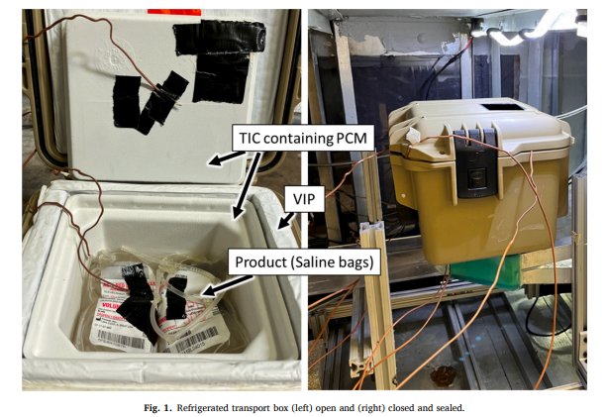
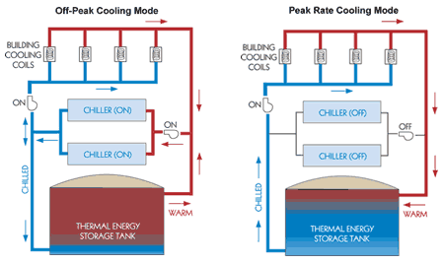
EXISTING PRODUCTS USING THERMAL MASS
Refrigerator Transport boxes
(Fauer and Cremaschi, 2024)
HVAC Application - Building AC
(Trane collaboration with Natgun, Ice Energy, and Calmac)
Successful in maintaining refrigerated temperature for duration of time
Reduces energy cost and carbon emissions by shifting electricity demand to off-peak
Presented by: Isabel
Notes:
Note that TIC thermal insulation chamber (Thermal isolation chamber)
PCM phase-change material (Phase change material)
VIP vacuum insulated panel (Vacuum insulation panel)

Slide 22
HOW OUR PRODUCT WILL FURTHER PASSIVE COOLING
Resilience and consistent energy independence
Reduce load during peak hours
Microcontroller efficiency optimization
Scalability for full-sized refrigerators
Presented by: Matthew

Slide 23
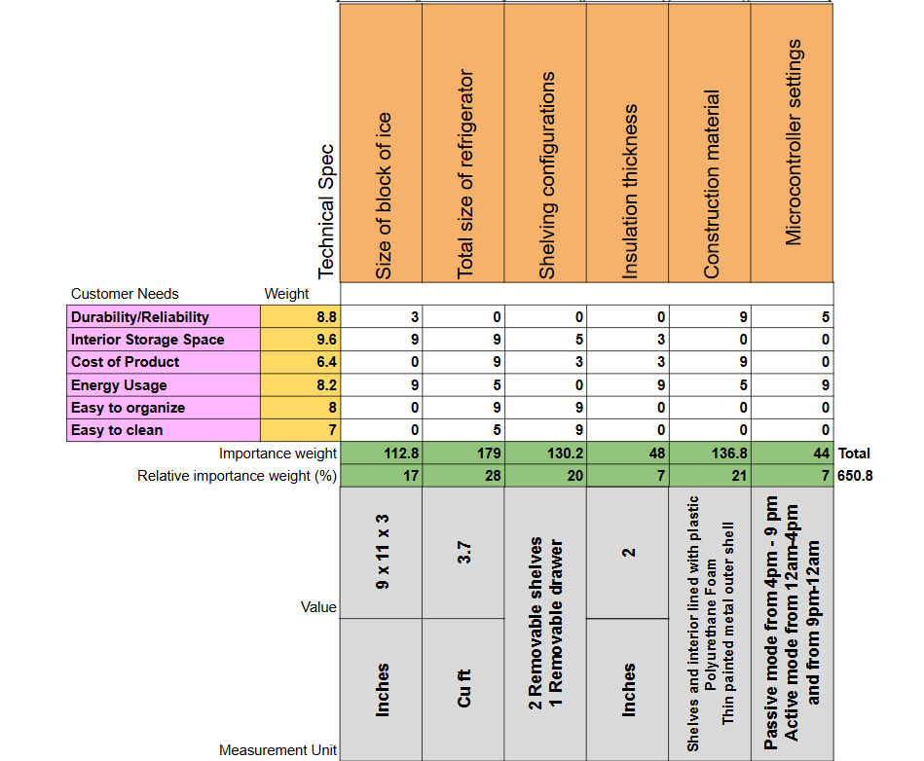
DESIGN SPECIFICATIONS
HOUSE OF QUALITY
Presented by: Caleb
Notes:
Caleb

Slide 24
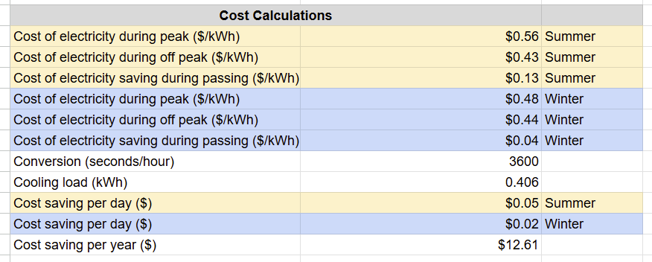
DESIGN SPECIFICATIONS
 | Control | Our Product
Price: | $200 | $250-$350
Energy Usage per Year | 320 Kwh/ yr | TBD
Presented by: Caleb
Notes:
Caleb

Slide 25
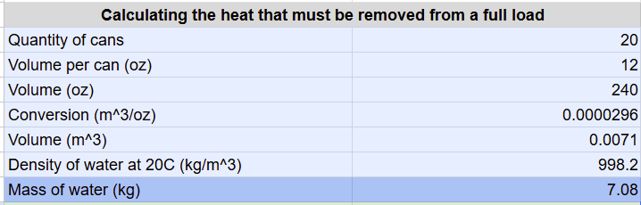
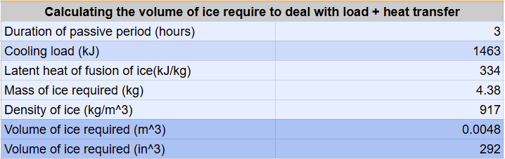
Ice Capacity Specifications
Presented by: Caleb
Notes:
Caleb
Grocery Load
M of water = cooling load
Total cooling Load

Slide 26
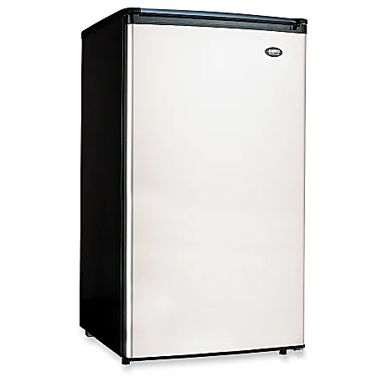
DESIGN SPECIFICATIONS
Total Internal Storage: 3.7 Cu Ft
Ice Volume: 0.17 Cu Ft
Available Internal Storage: ~ 3.0 - 3.3 Cu Ft
Dimensions
Height | 33.5”
Width | 18.6”
Depth | 19.9”
Presented by: Caleb
Notes:
Caleb

Slide 27

DESIGN CONSTRAINTS
Refrigerators must be maintained at or below 40°F (4°C)
Freezer temperature should be 0°F
Source: Food and Drug Administration (FDA)
Presented by: Kalino

Slide 28
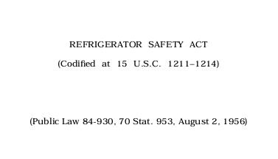
DESIGN CONSTRAINTS
Refrigerators must be openable from the inside for safety concerns
SOURCE: Consumer Product Safety Commission (CPSC)
Presented by: Kalino

Slide 29
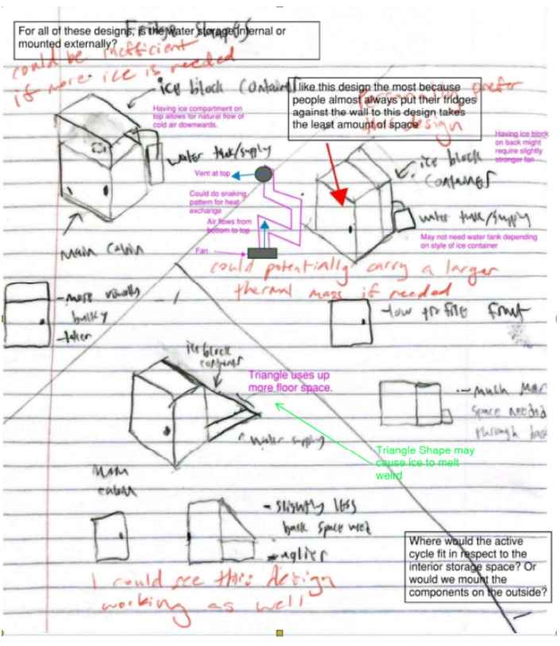
CONCEPTS AND DESIGN ALTERNATIVES
CONCEPT GENERATION
Initial brainstorming done with a mind map
Used the 6-3-5 technique modified for 5 group members
Each group member sketched 3 ideas on a piece of paper
Exchanged the papers 4 times
Added comments and ideas
Presented by: Brent

Slide 30
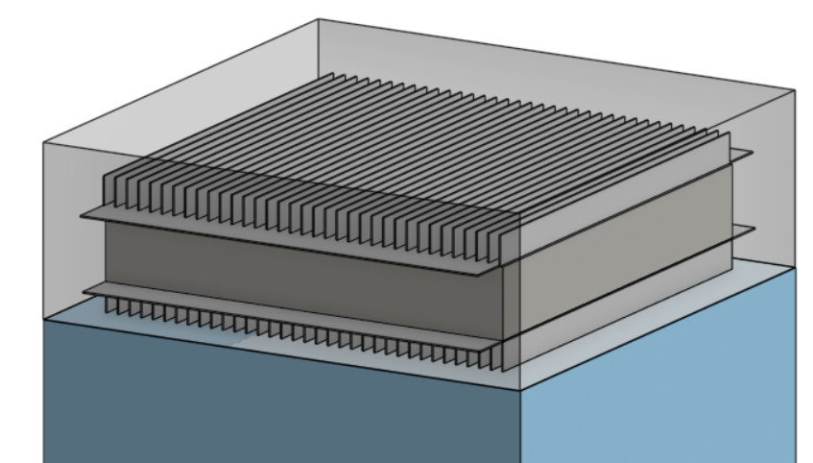
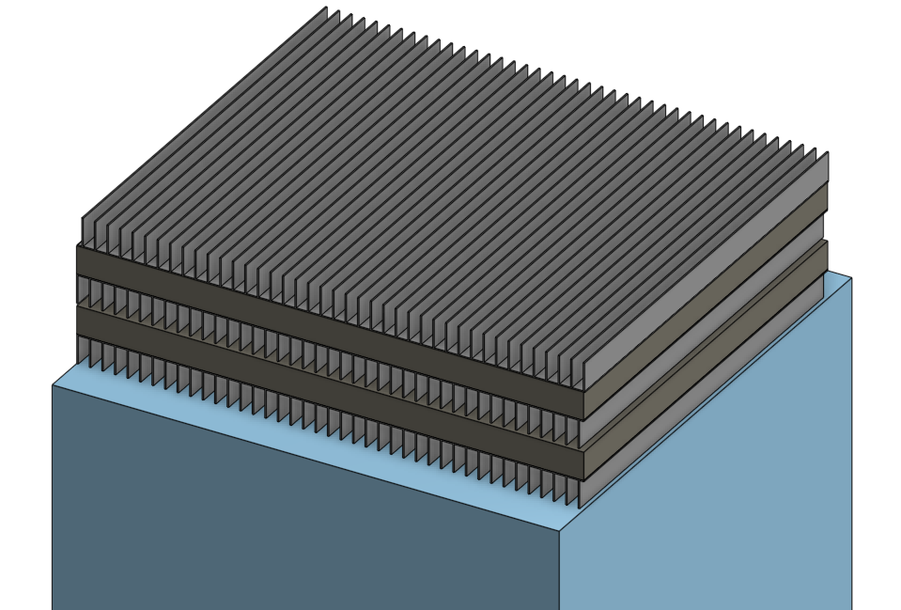
CONCEPTS AND DESIGN ALTERNATIVES
FIN/BLOCK SHAPE
Design 1
Design 2
Horizontal, top of refrigerator
One large ice block
Fins on top and bottom
Horizontal, top of refrigerator
Several thin layers of ice
Fins in between layers
Presented by: Isabel

Slide 31
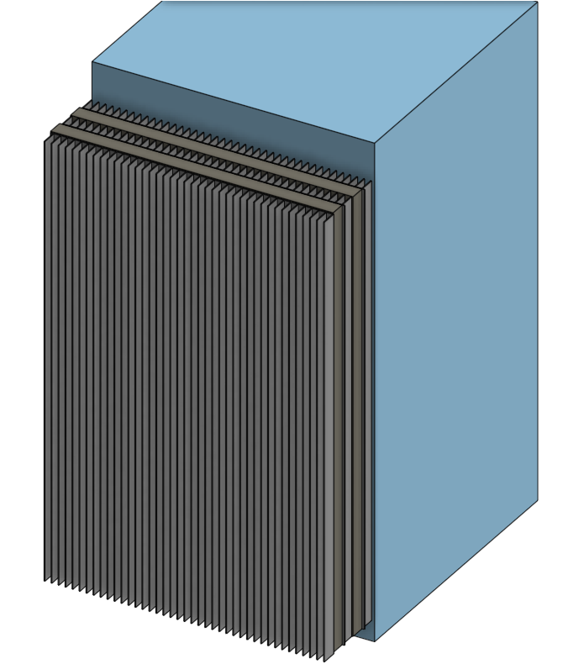
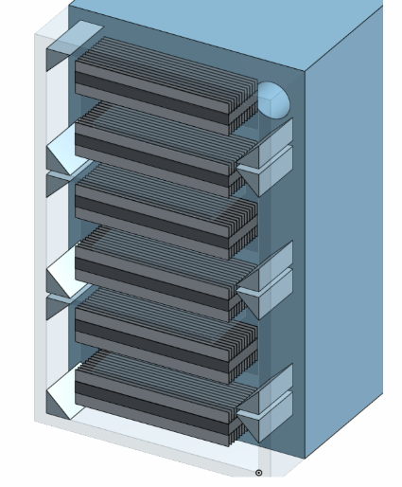
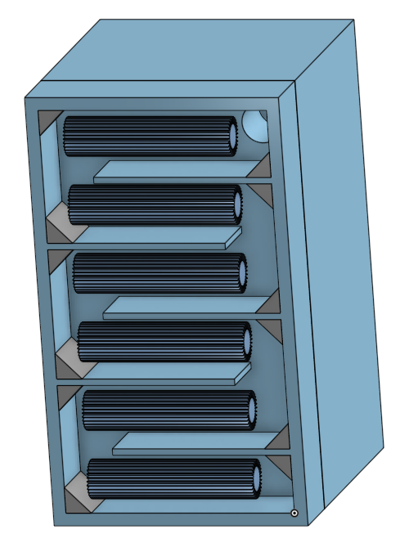
CONCEPTS AND DESIGN ALTERNATIVES
FIN/BLOCK SHAPE
Design 3
Design 4
Design 5
Vertical sheets of ice
Several thin layers
Winding airflow pattern
Horizontal, rectangular ice sheets
Winding airflow pattern
Horizontal, cylindrical ice sheets
Presented by: Isabel

Slide 32
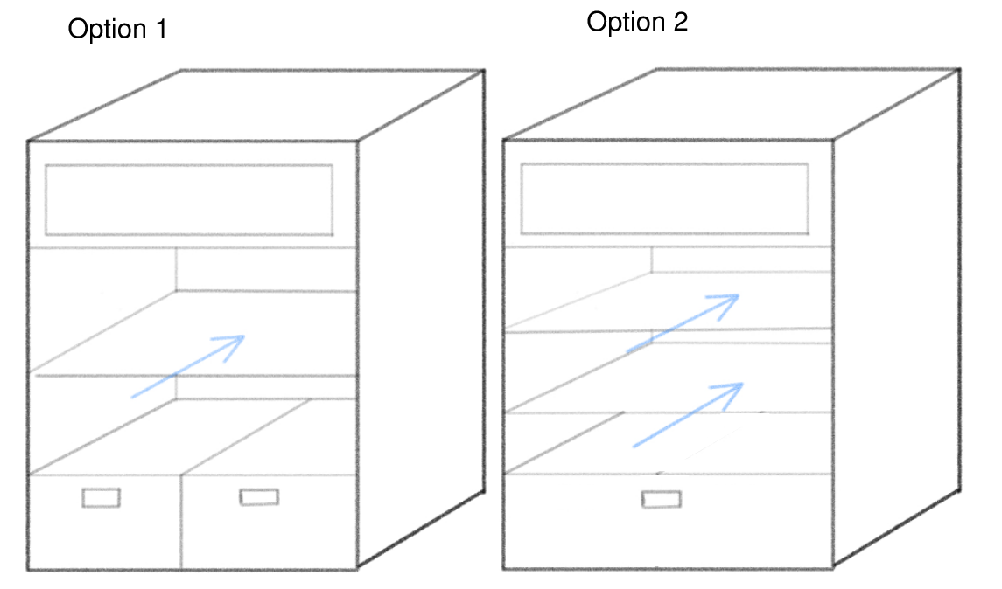
CONCEPTS AND DESIGN ALTERNATIVES
DRAWER/SHELF DESIGN
Design 1
Design 2
Other design considerations:
Removable shelves
Adjustable height
Single shelf
Two small drawers
Two shelves
One larger drawer
Presented by: Isabel

Slide 33
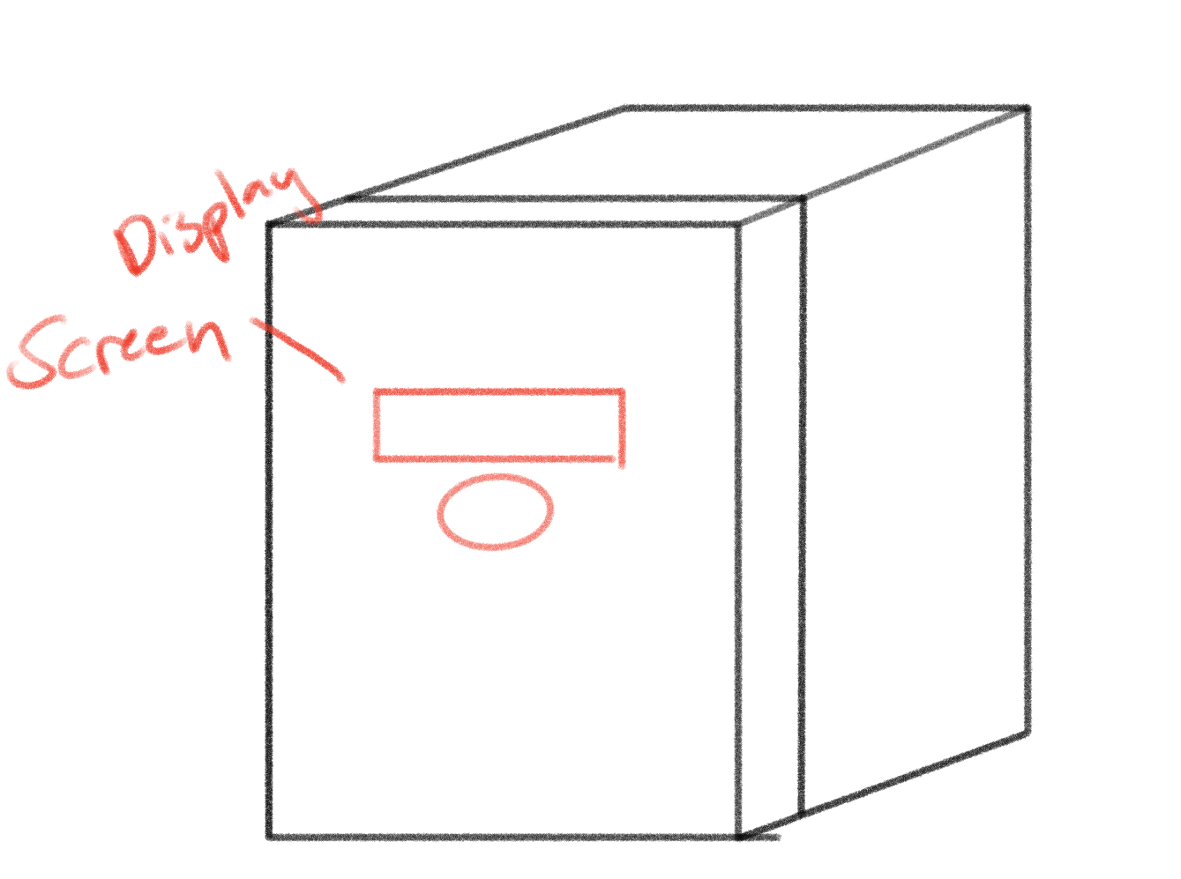
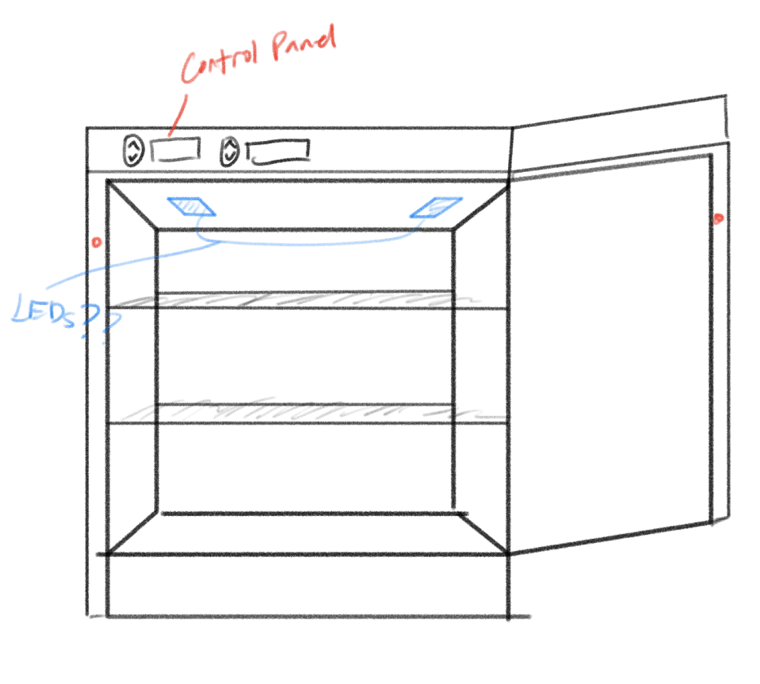
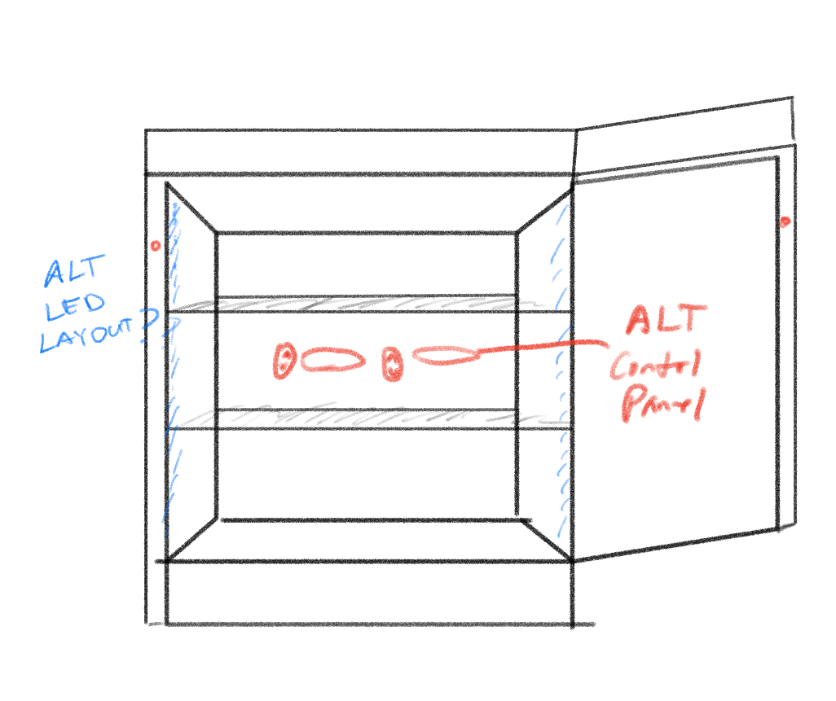
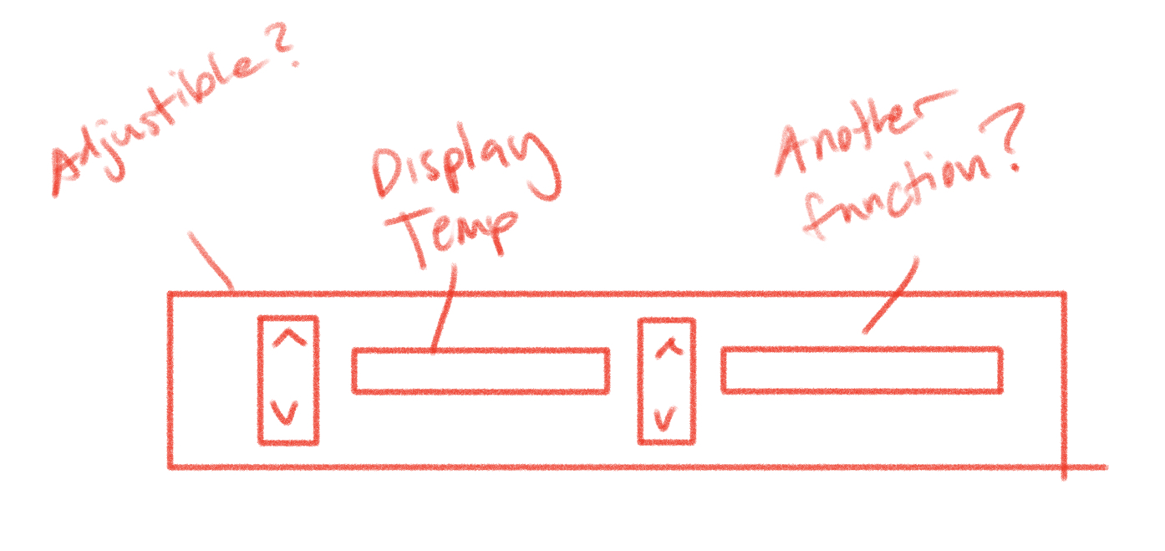
CONCEPTS AND DESIGN ALTERNATIVES
CONTROL PANEL
Placement 1
Placement 2
Placement 3
Control panel layout
Exterior
Outside of door
Interior
Top of door
Interior
Back of shelf
How many buttons?
How many indicators?
Presented by: Isabel

Slide 34
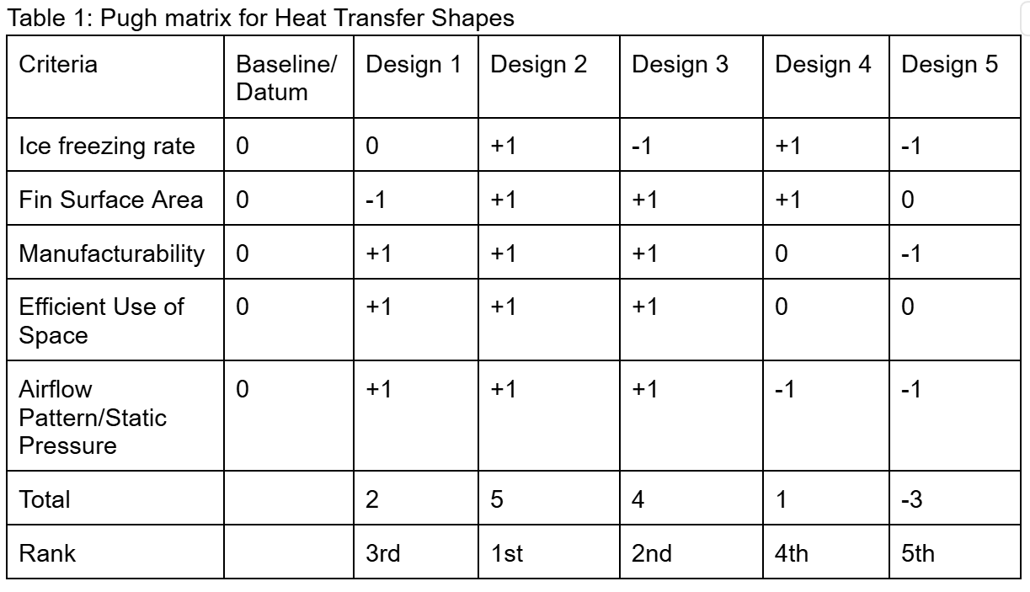
CONCEPT SELECTION PROCESS
FIN/BLOCK SHAPE
Presented by: Matthew
Notes:
Matthew

Slide 35
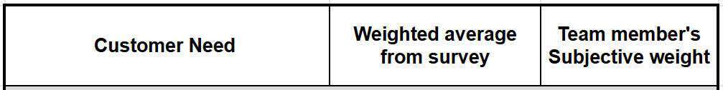
CONCEPT SELECTION PROCESS
DRAWER/SHELF DESIGN
Discussed pros and cons
Emphasized interior storage space and flexibility
Current shelf design of our mini fridge that we’re using
Presented by: Matthew

Slide 36
CONCEPT SELECTION PROCESS
CONTROL PANEL
Location:
Discussion based
Emphasis on customer needs
Layout:
Necessary interactions between microcontroller and user
Temperature adjustment not highly prioritized
Presented by: Matthew

Slide 37
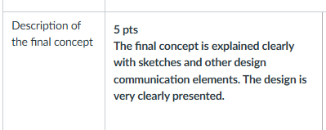
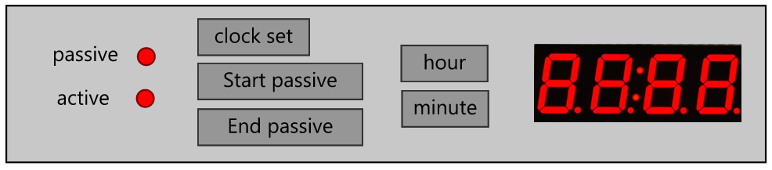
FINAL CONCEPT
37° fahrenheit internal temperature
Presented by: Brent
Notes:
Brent

Slide 38
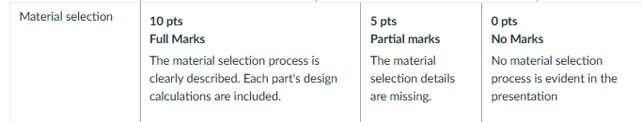
Material Selection
Talk about aluminum
Presented by: Brent
Notes:
Brent

Slide 39
ANTICIPATED CHALLENGES
Notes:
Caleb

Slide 40
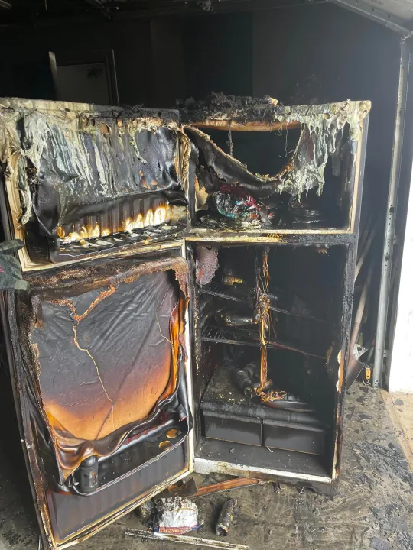
ANTICIPATED CHALLENGES
Availability, sustainability, and safety of refrigerants
Effective insulation
Effective passive cooling
Long payback period
Overall size of Unit
Presented by: Caleb

Slide 41
TEAM WORK
& SCHEDULE
Notes:
Matthew

Slide 42

TEAM WORK PLAN
Group Manager: Isabel
Communications Director: Kalino
Team Member Responsibilities
Heat transfer and Coding lead: Isabel
Fabrication lead: Caleb
Refrigeration lead: Brent
CAD/design lead: Kalino
Sensor/Mechatronics lead: Matthew
Presented By: Matthew

Slide 43
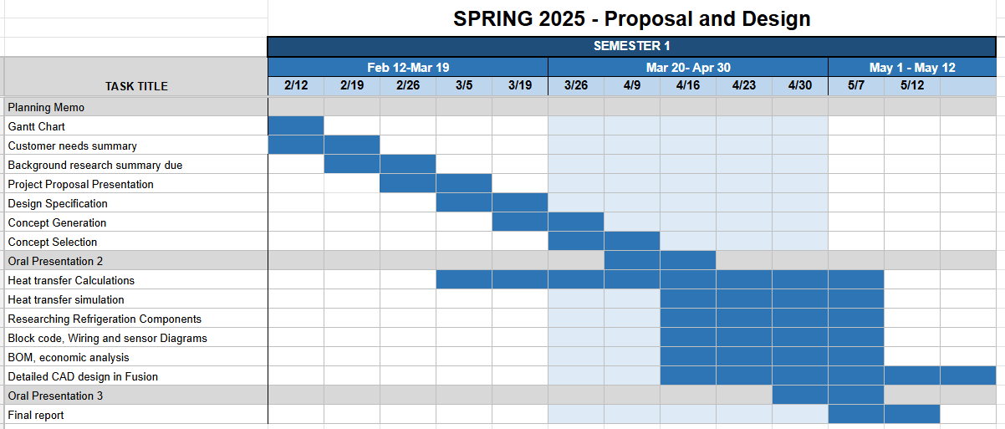
PROJECT TIMELINE/GANTT CHART
Presented by: Matthew

Slide 44
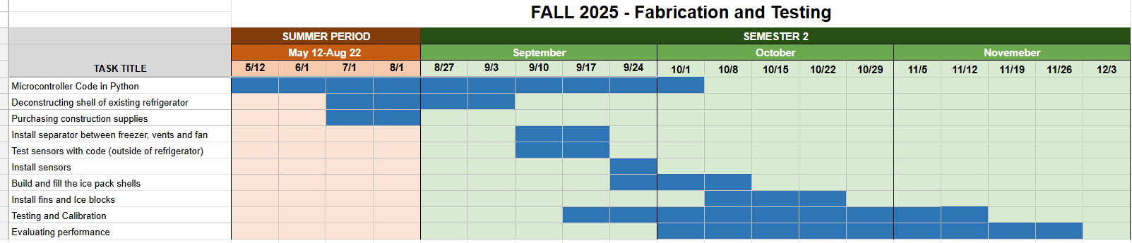
PROJECT TIMELINE/GANTT CHART
Presented by: Matthew

Slide 45
THANK YOU FOR YOUR ATTENTION!

Slide 46
QUESTIONS?

Slide 47
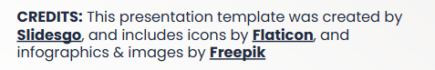
REFERENCES
Solar. (2023, March). A Timeline of PG&E’s Rate Increases – And How to Reduce Your Bill. Citadelrs.com; Citadel Roofing and Solar. https://blog.citadelrs.com/timeline-of-rate-increases-and-how-to-reduce-your-bill
Samayoa, M. (2024, December 21). PGE residential rates to climb 5.5%, bringing average monthly power bill to $160. Opb; OPB. https://www.opb.org/article/2024/12/20/portland-general-electric-residential-rates-increase-power-rate-hike-bill-price/
Wigness, S. (2024, January 2). PG&E Electric Rates in 2024: How to Lower Your Essential Electricity Costs. Solar.com. https://www.solar.com/learn/pge-electric-rates/
EIA’s residential energy survey now includes estimates for more than 20 new end uses. (n.d.). Www.eia.gov. https://www.eia.gov/todayinenergy/detail.php?id=37813
Fauer, C., & Cremaschi, L. (2024). Passive cooling of two phase change materials installed in series. International Journal of Refrigeration, 159, 124–133. https://doi.org/10.1016/j.ijrefrig.2023.12.024
Garber-Slaght, R. (2013, March). Passive Refrigeration. Cold Climate Housing Research Center; CCHRC. https://cchrc.org/wp-content/uploads/media/passiverefrigeration.pdf

